Slide 1
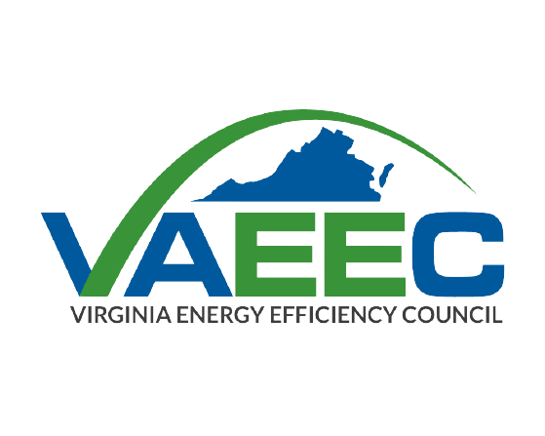
Energy Savings Performance Contracting (ESPC) Campaign Overview and Benefits for Participants
Notes:
NOTE: Areas highlighted in yellow should be edited by the presenter.
These slides are meant to support an introduction to ESPC and the U.S. Department of Energy’s ESPC Campaign.
These slides should be tailored to fit the audience and circumstances.
Potential audiences include organizations in the municipal and state governments, universities and colleges, schools, and hospitals (MUSH) market and other public sector entities interested in or actively engaged in implementing an energy savings performance contract.

Slide 2
What is Energy Savings Performance Contracting?
Organizations can pay for today’s building upgrades with tomorrow’s guaranteed energy savings with Energy Savings Performance Contracting (ESPC)
Proven, budget-neutral contracting and financing method for public sector building owners
Supports energy efficiency and renewable energy projects in public facilities
Projects are contracted to an energy service company (ESCO)
ESCO guarantees the energy savings, making up any shortfall
Projects funded and/or financed by customer and repaid with cost savings
Notes:
ESPC is a proven, budget-neutral contracting and financing method that is primarily used by the public sector, that can support energy and water efficiency retrofits, renewable energy integration, as well as other building and equipment upgrades.
Process Overview: A facility owner contracts with an energy service company (ESCO) to implement facility upgrades that are paid for over time with guaranteed energy, water, and cost savings, and the ESCO guarantees the energy savings and performance of the new equipment.
ESPC projects are implemented using funds (such as capital budget or grants), or financing obtained by the customer.
Nationwide, ESPC is approximately an $5 billion/year industry in the MUSH (municipal and state government, universities and colleges, schools, and hospitals) market.
Originated in the 1970s; 49 states have enacted ESPC legislation.
Consider adding a verbal mention of the State/City/County] project records and successes with ESPC in the past.
E.g., number of ESPC projects under the state program, $ savings estimate, etc.

Slide 3
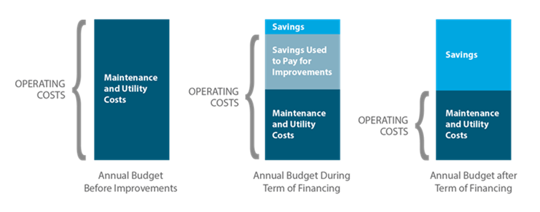
How Does ESPC Benefit Organizations?
Budget savings – especially once cost is paid back
Lowers energy costs and reduces impact of energy price swings
Decreases operating costs (e.g., automated controls save on labor)
Reduces maintenance costs (e.g., LED bulbs are replaced less often)
Generates positive cash flow – payback covered by cost savings
3
Notes:
Note that projects can be structured to be either cash flow positive or neutral during the payback period.
This graph illustrates a cash-flow positive payback period.
A cash-flow neutral structure has the benefit of delivering even bigger budget savings over the long run.

Slide 4
Additional ESPC Benefits
Extends the capabilities of existing budgets: no need for operating budget allocation or capital budget appropriation, but has leveraging effect on contributed funds
Tackles deferred maintenance and avoids disruption from equipment failure
Improves indoor environments: air quality, lighting, temperature control, and productivity
Stops the waste of energy dollars
Reduces emissions of carbon dioxide, sulfur, and other pollutants
Creates jobs and supports local economic development
Increases resilience for reliable use of community facilities
4
Notes:
Presenters: Highlight, re-order, or add additional benefits as you see fit for the audience.
Other benefits that may be appropriate to mention include:
Energy security/independence
Resource stewardship
Greenhouse gas emissions reduction
Opportunities for renewable energy integration
Contribute to meeting demand side management (DSM) goals
Help champion cost-effective government

Slide 5
Support for Implementing ESPC
Connect with State Resources
Virginia has an office responsible for advising ESPC activities:
Virginia Department of Energy (‘Virginia Energy’)
Primary points of contact:
RenewableEfficiency@energy.virginia.gov
Connect with Federal Resources
Visit the Performance Contracting National Resource Center
Explore the U.S. Department of Energy (DOE)’s ESPC Toolkit
Access Federal Technical Assistance
Join DOE’s ESPC Campaign!
Notes:
Presenters: It is useful to provide actionable information to the audience regarding available state ESPC programs/resources and contacts. Additional information you may provide here can include the following:
Relevant goals/targets
“ESPC is an important tool in helping [State/City/County] make progress towards its policy goals.”
ESPC Program resources often include a state ESPC manual, FAQs, or model contract documents to assist with a project.
DOE’s Performance Contracting National Resource Center and ESPC Toolkit contain tools, educational guides, and other resources to assist ESPC customers in preparing for and implementing an ESPC project.
DOE’s new ESPC Campaign enhances

Slide 6
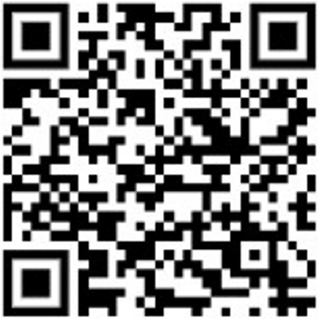
U.S. Department of Energy ESPC Campaign
Current State
The Energy Savings Performance Contracting (ESPC) Campaign engages organizations and stakeholders in the municipal and state governments, universities and colleges, schools, and hospitals (MUSH) market to:
Expand and enhance the use of ESPC
Share and leverage practical resources and best practice approaches
Achieve significant energy, environmental and cost savings benefits
Program Outcomes
Goal: Partners will collectively achieve $1 billion in measured & verified savings
Become an ESPC Champion!
ESPC Champions are public institutions and building owners like you that are ready to share and strengthen performance contracting knowledge and implement an ESPC project to meet energy, operational, and environmental goals!
6
Notes:
Presenters: Swap this slide with slide 11, depending on your audience
The ESPC Campaign is a national initiative that engages states, local governments, schools, universities, hospitals, as well as market stakeholders to support, expand, and enhance the use of ESPC to achieve significant energy, environmental, and cost savings across the public sector.
Through this initiative, DOE works with Campaign partners to increase awareness of the benefits of performance contracting, and to share practical resources and best practice approaches that will strengthen ESPC and measurement and verification knowledge and implementation.
ESPC Campaign partners contribute to the collective goal of reaching $1 billion in measured and verified savings from ESPC, which is framed around the cornerstone of an ESPC contract, the savings guarantee.
ESPC Champions are state and local agencies, K-12 school districts, institutions of higher education, hospitals, and other public sector entities seeking to connect with DOE and peer resources, share lessons learned, solutions, and best practices, and showcase the impact of their ESPC projects.

Slide 7
ESPC Campaign Participation Benefits
ESPC Campaign participants gain access to DOE technical assistance offerings, including:
Use the ESPC Campaign resources to support the following outcomes:
Build ESPC knowledge and technical capacity
Maximize the impact of available funds
Replicate lessons in your own projects to increase efficiency, address deferred maintenance, improve resiliency, and reduce emissions
Demonstrate impacts with measured and verified savings
Receive recognition for exemplary projects and achievements
Current State
Expert-led Training Series
Topical Webinars
Peer Exchange and Networking Opportunities
“Ask-an-Expert” Office Hours
Resource Library
7
Notes:
DOE’s technical assistance curriculum is designed to answer your questions.
Live, expert-led training will help build your team’s ESPC and M&V knowledge and point you to relevant resources.
Webinars will address topics that are responsive to partners’ interests and will feature partner insights and case studies.
Peer exchange is a key component of the ESPC Campaign. Learn from similar organizations, as well as from others in your geographic area.

Slide 8
Why We Recommend the ESPC Campaign
Develop Strong Practices, Highlight Your Successes
Equips organizations to plan and implement successful projects and supports team capacity building
Highlights actionable solutions and approaches with case studies and lessons learned from ESPC Campaign partners
Discover M&V best practices to ensure savings guarantees are met or exceeded
Maximize the impact of federal, state, and other funding opportunities
Contribute to and leverage a national database of project and M&V data to demonstrate impact and inform future activity
Showcase achievements and receive recognition on a national platform
8
Notes:
Joining DOE’s ESPC Campaign helps organizations develop and implement effective practices, connect with peers, and demonstrate successes in performance contracting.

Slide 9
Next Steps
Explore
Explore if ESPC is right for your organization
Learn
Learn more about the ESPC Campaign
Contact
Contact the DOE ESPC Campaign team to enroll
Join!
Submit the partnership agreement
Examine DOE’s ESPC Toolkit
Visit the campaign website
Email at ESPCcampaign@hq.doe.gov
Join the ESPC Campaign today!
Questions?
Contact us with additional questions about ESPC or the U.S. Department of Energy’s ESPC Campaign
jessica@vaeec.org
9
Notes:
For organizations new to ESPC, working with your state energy office is a great way to start off on the right foot with the tools, resources, and guidance necessary to complete a successful ESPC. Look out for funding opportunities that can be applied to an ESPC project and visit the ESPC Campaign website for more information on technical assistance resources from the Department of Energy.
Presenters: Provide contact information and recommend that audience members follow up with you or the DOE ESPC Campaign team for more information.

Slide 10
Additional Resources
Energy Savings Performance Contracting: Improving Infrastructure & Turning Waste into Wins
ESPC Financing Options
Understanding Your ESPC Savings Guarantee
eProject eXpress
An Ally in Your Corner: Benefits of Using Owner's Representatives
Model Contract Documents for an Energy Savings Performance Contract Project
Performance Contracting National Resource Center
Energy Services Coalition
10
Notes:
Use these resources to continue learning about ESPC and explore its fit for your organization’s needs.

Slide 11
U.S. Department of Energy ESPC Campaign
Current State
The Energy Savings Performance Contracting (ESPC) Campaign engages organizations and stakeholders in the municipal and state governments, universities and colleges, schools, and hospitals (MUSH) market to:
Expand and enhance the use of ESPC
Share and leverage practical resources and best practice approaches
Achieve significant energy, environmental and cost savings benefits
Program Outcomes
Goal: Partners will collectively achieve $1 billion in measured & verified savings
Become a Campaign Leader!
Campaign Leaders are ESPC program leaders like you that are ready to promote performance contracting awareness and readiness by others to support energy savings, resilience, environmental, and other lead-by-example goals!
11
Notes:
Presenters: Swap this slide with slide 6, depending on your audience
The ESPC Campaign is a national initiative that engages states, local governments, schools, universities, hospitals, as well as market stakeholders to support, expand, and enhance the use of ESPC to achieve significant energy, environmental, and cost savings across the public sector.
Through this initiative, DOE works with Campaign partners to increase awareness of the benefits of performance contracting, and to share practical resources and best practice approaches that will strengthen ESPC and measurement and verification knowledge and implementation.
ESPC Campaign partners contribute to the collective goal of reaching $1 billion in measured and verified savings from ESPC, which is framed around the cornerstone of an ESPC contract, the savings guarantee.
Campaign Leaders are State Energy Offices or other organizations prepared to establish, strengthen, and expand programs to support public entities in using ESPC. Campaign Leaders encourage public institutions in their state to participating in the ESPC Campaign and draw on their unique ability to work with ESPC Champions to tackle barriers, adopt best practices, meet local requirements, and demonstrate impact. Campaign Leaders connect with DOE and peer resources, share lessons learned, solutions, and best practices, and showcase the impact of their ESPC programs.

