Slide 1
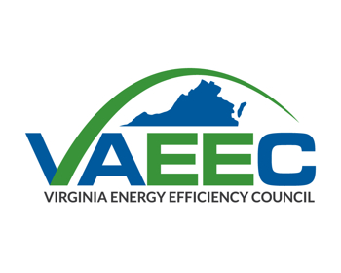
VAEEC Programmatic Update
Chelsea Harnish
Executive Director
Virginia Energy Efficiency Council
November 29, 2016

Slide 2
Fall Meeting Agenda
1:20 Welcome and VAEEC Programmatic Update
1:20-2:00 Member Round Robin
2:00-2:30 Networking Break
2:30-3:00 Concurrent Sessions (choose one)
Update on the Governor’s Executive Committee
Leveraging Energy Data to Accelerate Energy Efficiency
Implementing PACE Throughout the Commonwealth
3:00-3:50 What is the Vision for Virginia’s Energy Efficiency Future?
3:50-4:00 Closing Remarks
4:00-6:00 VAEEC Energy Efficiency Leadership Awards Ceremony
Notes:
Here is the agenda for today’s events (note how different from previous meetings)
Next, I’m going to present a few slides on our membership demographics before diving into our programmatic updates

Slide 3
VAEEC Membership Comparison by Year
Notes:
From right to left: Academic (red), Associate (light green), Business Gold (dark green), Business Platinum (navy blue), Business Silver (yellow), Government (dark blue) and Individual (light blue)

Slide 4
2016-2017 VAEEC Membership by Category
Notes:
Our Business Silver, and Individual members are our most popular membership levels with Government and Associate levels following closely behind.

Slide 5
Industry Census

Slide 6
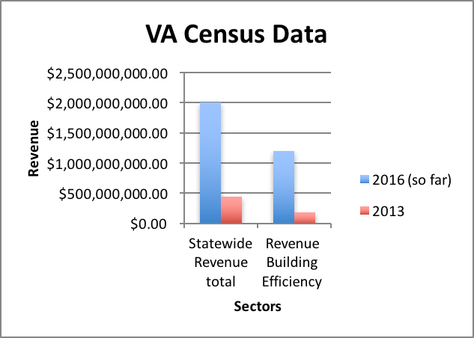
Industry Census Report: Preliminary 2016 Data
Notes:
Respondents:
2013- 318 firms
2016- 538 firms
Statewide revenue totals for all clean energy sectors
2013- almost half a million
2016- $2.2 billion
Building efficiency revenue
2013- nearly $200 million
2016- $1.2 billion
Our 2013 census of total EE revenue was $300 million

Slide 7

Energy Efficiency Opportunities in 2016 and Beyond
Governor’s Executive Committee on EE
Property Assessed Clean Energy (PACE)
Building Codes
Utility Regulation

Slide 8
PACE: Property Assessed Clean Energy
What’s new?
VA Community Capital Report Findings:
Education, Outreach and Guidance essential for success of PACE programs
Centralized, “plug-n-play” program highly desired by localities
Preference for seeing how PACE is adopted in other jurisdictions before taking the proverbial plunge.
Tri-State DOE grant application
Virginia, Maryland and DC awarded DOE grant
3 year, $500,000 grant across the region
Assist in developing statewide program
Notes:
Earlier this year, the Commonwealth, along with Maryland and DC applied for a SEP grant to assist in developing standardized marketing, outreach, technical and financial documentation for statewide adoption of PACE. As a partner on this grant, VAEEC will help increase market awareness of PACE through coordinated outreach to key stakeholders whose participation in PACE will accelerate its adoption and growth in the region.
VAEEC is at the forefront of these endeavors by helping to centralize communication regarding efforts to develop a statewide program.

Slide 9
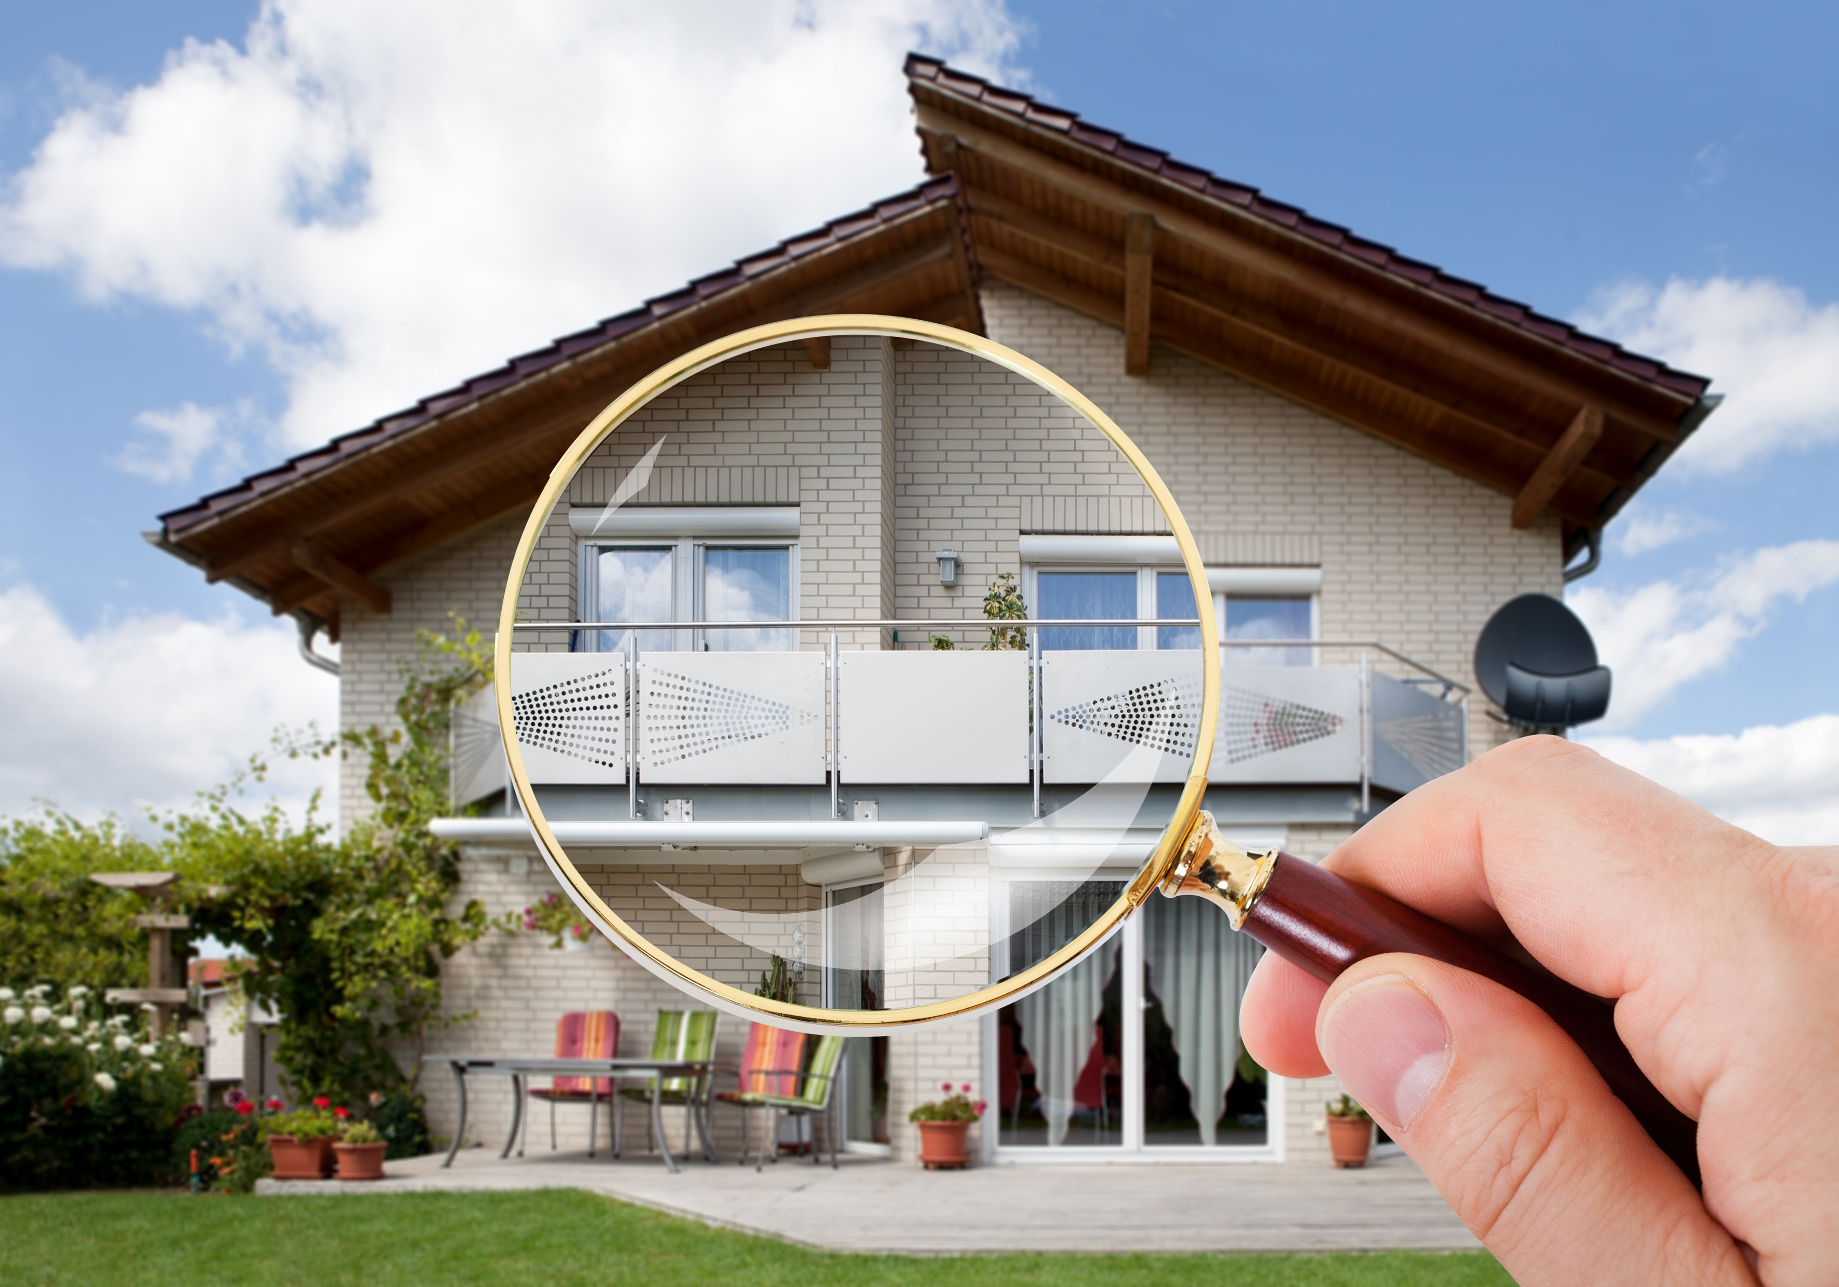
VA Building Codes Update: Timeline
December 2016: Board votes on draft regulations
February-June 2017: Public comment period on draft regulations
Spring-Summer, 2017: Work Groups start up; amendment proposals accepted
June 2017: Public Hearing on draft regulations
September and October 2017: DHCD board committees meet to adopt final regulations
November 2017: DHCD board adopts final code regulations
Notes:
Federal code standards are released every 3 years (2009, 2012 and 2015)
States are not mandated to adopt the federal standards but are required to go through a 3-year update as well
Board of the Department of Housing and Community Development (DHCD) is charged with updating Virginia’s building codes
The 2012 federal standards were a major advancement for energy efficiency; Virginia rejected those standards

Slide 10

Utility Regulation
Continue to play supportive role to our utility members before the State Corporation Commission
Participate in stakeholder processes whenever possible
Build relationships with SCC staff and commissioners
Hold workshops and events on new trends and topics

Slide 11

Legislative Support
2016 HB 1174:
Electric energy consumption reduction goal; progress reports. Directs the Department of Mines, Minerals and Energy, in consultation with the staff of the State Corporation Commission, to report annually, commencing no later than December 15, 2017, on the progress the Commonwealth is making toward meeting the goal adopted in 2007 of reducing the consumption of electric energy by retail customers by the year 2022 by an amount equal to 10 percent of the amount of electric energy consumed by retail customers in 2006. The reports are to be made to the General Assembly and the Governor's Executive Committee on Energy Efficiency or, if that Committee ceases operations, to the Governor.

Slide 12












Thank you to our sponsors!

Slide 13
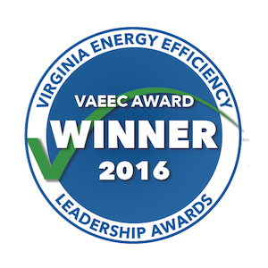
How to spot an award winner?
Notes:
All of our award winners who will be honored later today have this logo at the top of their nametag. If you find yourself in conversation with one of them, please congratulate them on their efforts.

Slide 14
Questions?
Chelsea Harnish
chelsea@vaeec.org
804.457.8619
www.vaeec.org
Notes:
In closing, now that you know more about our work, I hope you will become more engaged with our efforts.

