Slide 1
Energy Efficiency Financing
October 15, 2015

Slide 2
About Virginia Community Capital
Founded in 2006, then Governor Mark Warner privatized $15M state loan funds to create VCC
VCC is a non-profit community development financial institution (CDFI) loan fund
  $121 million in consolidated assets
  $94 million loan portfolio
  Lending $50-55 million per year in Virginia
Community Capital Bank of Virginia (CCB) is a for profit community development bank
  State chartered bank subsidiary
  B certified corporation – mission driven
  $67 million in deposits
  Business focused vs. consumer focused

Slide 3
VA SAVES - Green Community Program
Interest Rate Subsidy Program- approx. 3%
Utilizing Virginia’s Allocation of Federal Qualified Energy Conservation Bonds
Local Governments and Private Sector
Commercial Scale- Energy Efficiency and Renewable Energy Projects
Limited Allocation- $20 million
Learn More: www.vasavesgcp.com

Slide 4
Property Assessed Clean Energy – PACE
Energy efficiency, renewable energy and water efficiency loan program
Set up by locality (required by law)
Private lenders make these loans
Repaid on real estate tax bill
Lien is senior to existing mortgage- equal status as a real estate tax lien
Loan stays with property upon resale

Slide 5
Property Assessed Clean Energy – PACE
PACE legislation passed in 2015
Virginia Bankers Association- neutral position
Existing mortgage holder must subordinate
Commercial, Industrial, Multifamily (not SF)
Requires localities to set up PACE programs
Private lenders can participate

Slide 6
PACE – Solution to Market Place Program
Property owners unwilling to invest in long payback energy projects due to short duration of property ownership
No long term loans (beyond 10 years) for energy projects.
Cash flow positive day one

Slide 7
Why Building Owners Like PACE
100% upfront financing
Obligation secured by property
  Enables up to 20-year terms
  Can be passed on to tenants
  Transfers to subsequent owners upon property sale
Positive cash flow in first year
Energy savings offset property tax assessment

Slide 8
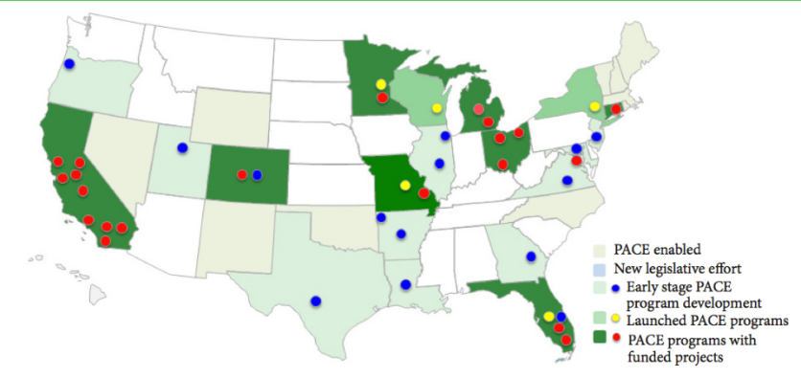
PACE Across the Country

Slide 9
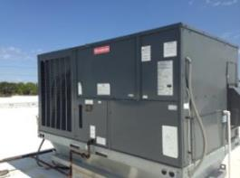
Case Study: Medical Office
50,000 SF low rise medical office
Built early 1980s
Needed upgrades to HVAC & controllers
$270,000 budget
Rate between 6% -7%, 20 year term, full amortizing, non recourse
PACE LTV: <5% of assessed value, Total Load: <75% of assessed value
Avoided additional debt on balance sheet
No personal guarantees required
100% project financing

Slide 10
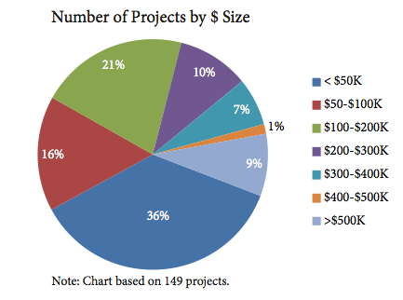
PACE- Project Size

Slide 11
Why Is PACE Good for Cities
Provides local business owners with 100% upfront financing for critical capital improvements to their buildings – tangible retention strategy
Creates local employment opportunities for G.C.s, trades, engineers, vendors, etc.
Serves as redevelopment tool for “tired” buildings with obsolescent and inefficient systems.

Slide 12
Bill Greenleaf
Virginia Community Capital
804-939-6165
bgreenleaf@vccva.org

