Slide 1
2015 State Energy Efficiency Scorecard
Mary Shoemaker
Fall Meeting, VA Energy Efficiency Council
November 12, 2015

Slide 2
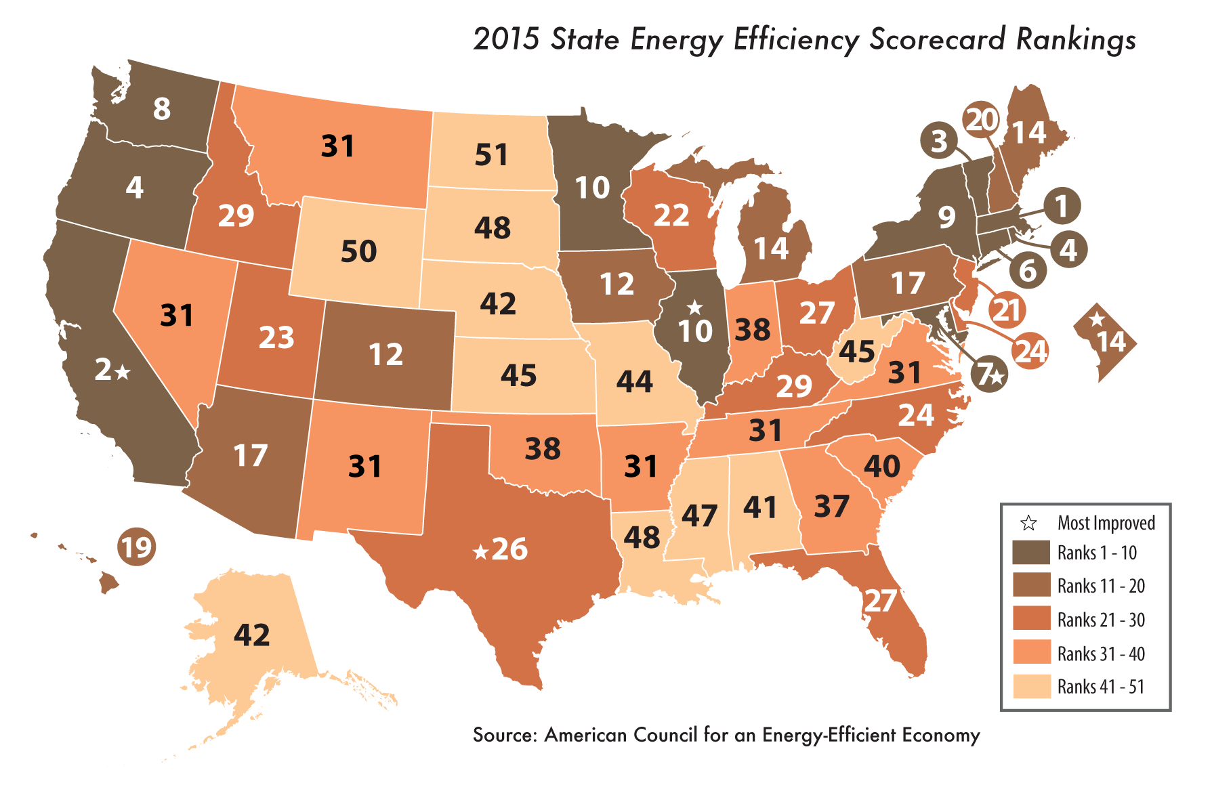

Slide 3
Top Ten*
Rank | State | Utility & public benefits programs & policies (20 pts.) | Trans-portation policies (10 pts.) | Building energy codes (7 pts.) | Combined heat & power (4 pts.) | State gov. initiatives (7 pts.) | Appliance efficiency standards (2 pts.) | TOTAL SCORE (50 pts.) | Change in rank from 2014 | Change in score from 2014
1 | Massachusetts | 20 | 8.5 | 6 | 4 | 5.5 | 0 | 44 | 0 | 2
2 | California | 14 | 10 | 7 | 4 | 6.5 | 2 | 43.5 | 0 | 3
3 | Vermont | 19 | 7 | 6.5 | 2 | 5 | 0 | 39.5 | 0 | 2
4 | Oregon | 13 | 8 | 6.5 | 2.5 | 5.5 | 1 | 36.5 | -1 | -1
4 | Rhode Island | 20 | 5 | 5 | 3 | 3 | 0.5 | 36.5 | -1 | -1
6 | Connecticut | 15 | 6 | 5 | 3 | 5.5 | 1 | 35.5 | 0 | 0
7 | Maryland | 12 | 7 | 6.5 | 4 | 5 | 0.5 | 35 | 2 | 5
8 | Washington | 11 | 8 | 6.5 | 2.5 | 5 | 0.5 | 33.5 | 0 | 0
9 | New York | 10 | 8.5 | 5 | 3 | 6 | 0 | 32.5 | -2 | -2.5
10 | Illinois | 10 | 6 | 7 | 2 | 6 | 0 | 31 | 1 | 4
10 | Minnesota | 13.5 | 4 | 5.5 | 2 | 6 | 0 | 31 | 0 | 2
31 | Virginia | -0.5 | 5 | 4 | 0 | 4.5 | 0 | 13 | 4 | 0.5

Slide 4
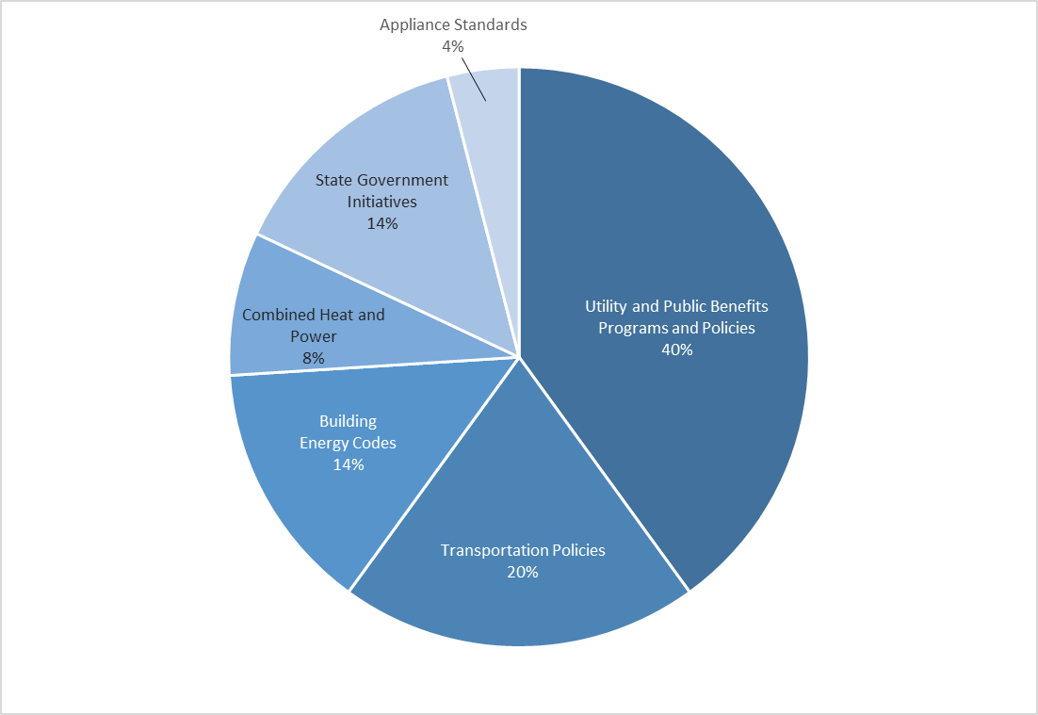
Policy Categories

Slide 5
How does Virginia stack up regionally?

Slide 6
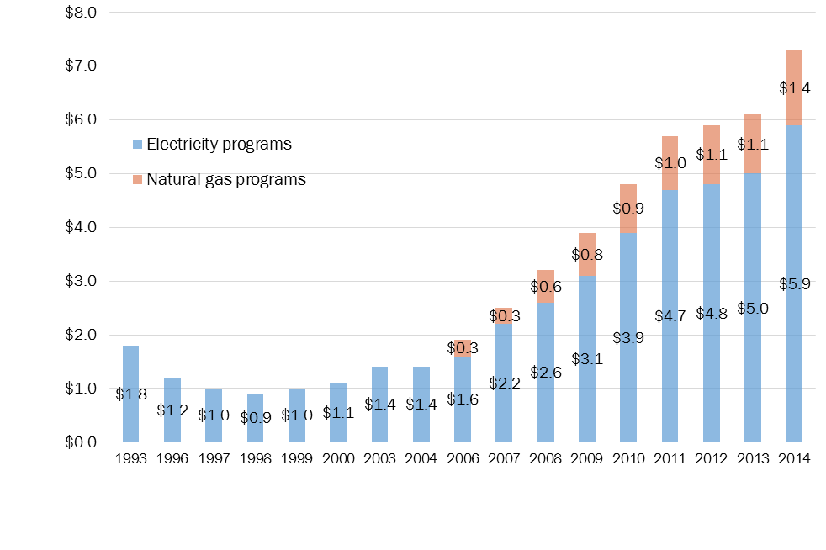
Key Findings: Utility Spending

Slide 7
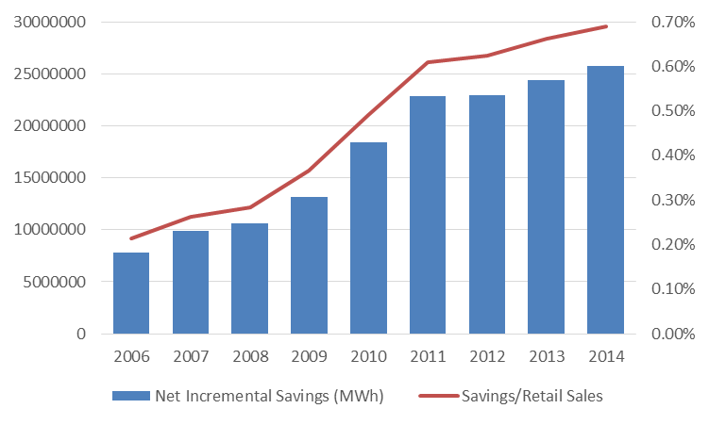
Key Findings: Electricity Savings
Net incremental savings (2014) = 25.7 million MWh (+6%)

Slide 8
Top Electricity Savings
State | 2014 net incremental savings (MWh) | % of 2014 retail sales | Score (6 pts.)
Rhode Island | 268,468 | 3.51% | 6
Massachusetts | 1,339,026 | 2.50% | 6
Vermont | 102,770 | 1.85% | 5.5
California | 4,082,256 | 1.58% | 4.5
Arizona | 1,190,123 | 1.57% | 4.5
Hawaii | 144,240 | 1.53% | 4.5
Michigan | 1,386,912 | 1.35% | 4
Connecticut | 387,863 | 1.32% | 3.5
Maryland | 792,354 | 1.29% | 3.5
Oregon | 595,548 | 1.27% | 3.5
Minnesota | 824,756 | 1.22% | 3.5
Maine | 145,413 | 1.21% | 3.5
Iowa | 550,035 | 1.17% | 3.5
Illinois | 1,513,045 | 1.08% | 3
Ohio* | 1,565,049 | 1.05% | 3
Washington | 946,565 | 1.02% | 3
New York | 1,338,551 | 0.92% | 2.5
Virginia | 26,233 | 0.02% | -0.5

Slide 9
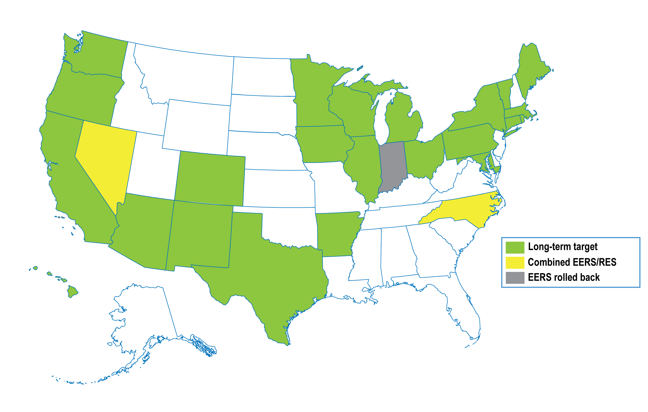
Key Findings: EERS

Slide 10
Why Are States Falling in the Rankings?
Outdated building energy codes
Large customers opt-out
Other states are ramping up

Slide 11
Opportunities
Enforce energy savings target
Engage large customers
Update and enforce building codes
Incentivize Combined Heat and Power
Results
Meet Governor McAuliffe’s 10% energy use reduction strategy
Meet Virginia’s emissions reduction target under the Clean Power Plan

Slide 12
Feedback and Questions
Contact Mary Shoemaker
mshoemaker@aceee.org

Slide 13
Point Breakdown
Policy areas and metrics | Maximum score | % of total points
Utility and public benefits programs and policies | 20 | 40%
Spending on electricity efficiency programs | 4 | 8%
Spending on natural gas efficiency programs | 2 | 4%
Incremental savings from electricity efficiency programs | 6 | 12%
Incremental savings from natural gas efficiency programs | 3 | 6%
Large customer opt-out programs* | (–1) | NA
Energy efficiency resource standards (EERSs) | 3 | 6%
Performance incentives and fixed cost recovery | 2 | 4%
Transportation policies | 10 | 20%
Greenhouse gas (GHG) tailpipe emissions standards | 1.5 | 3%
Electric vehicle (EV) registrations | 1 | 2%
High-efficiency vehicle consumer incentives | 0.5 | 1%
Targets to reduce vehicle miles traveled | 1 | 2%
Change in vehicle miles traveled | 1 | 2%
Integration of transportation and land use planning | 1 | 2%
Complete streets policies | 1 | 2%
Transit funding | 1 | 2%
Transit legislation | 1 | 2%
Freight plans and energy efficiency targets | 1 | 2%
Building energy codes | 7 | 14%
Level of code stringency | 4 | 8%
Code compliance study | 1 | 2%
Code enforcement activities | 2 | 4%
Combined heat and power | 4 | 8%
Interconnection standards | 0.5 | 1%
Policies to encourage CHP as a resource | 2 | 4%
Additional incentives for CHP | 0.5 | 1%
Additional policy support | 1 | 2%
State government initiatives | 7 | 14%
Financial incentives | 2.5 | 5%
Energy disclosure policies | 1 | 2%
Lead-by-example efforts in state facilities and fleets | 2 | 4%
Research and development | 1.5 | 3%
Appliance and equipment efficiency standards | 2 | 4%
Maximum total score | 50 | 100%

