Slide 1
Energy Efficiency in Arlington County John Morrill, Energy Manager jmorrill@arlingtonva.us Virginia Energy Efficiency Council, Richmond November 12, 2015

Slide 2
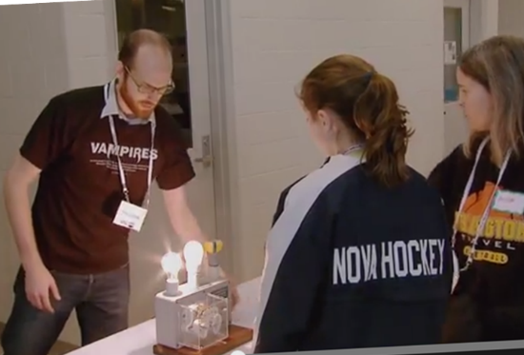
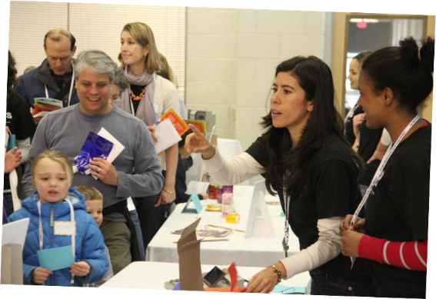
Arlington Initiative to Rethink Energy
Overview of program
Recent highlights
Focus on recent successes with LEDs.
2

Slide 3
Arlington Initiative to Rethink Energy
Launched 2007, built upon existing programming
Local government action on climate change
Goal: Cut GHG emissions from operations 10% by 2012
Energy efficiency focus, with cleaner power & fuels
Community engagement, develop community plan
3

Slide 4
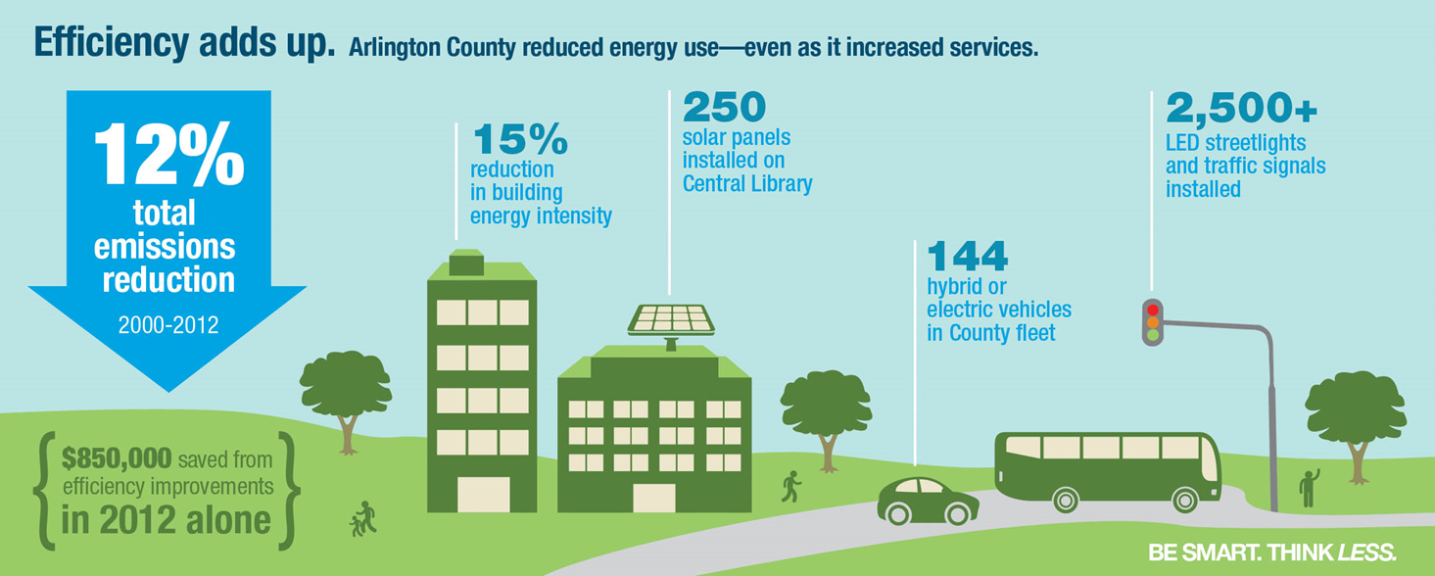
Success!
4

Slide 5
Building Upon Success
Community Energy Plan adopted June 2013
New element of Comprehensive Plan
Headline Goal:
Cut GHG emissions from 13 mt/capita to 3 mt/capita by 2050
Loading order:
1. Improve energy efficiency
2. Pursue heat recovery (large and small)
3. Renewables as clean fuel
4. Integrated planning with distributed generation
5

Slide 6

Building Upon Success
How achieve 75% improvement in 35 years?
Raise the bar – we joined the DOE Better Buildings Challenge
Interim target: 20% reduction in energy/sq. ft. by 2020 vs. 2009.
6

Slide 7

Building Upon Success
How achieve 75% improvement in 35 years?
We raised the bar – joined the DOE Better Buildings Challenge
Interim target: 20% reduction in energy/sq. ft. by 2020 vs. 2009.
With gains made 2000–2012, how are we going to get another 20 percent?
7

Slide 8
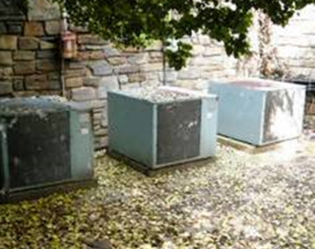
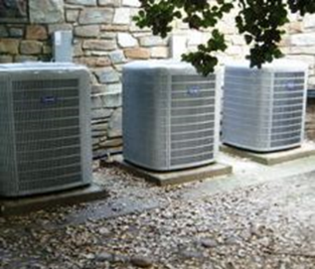
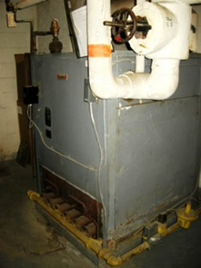
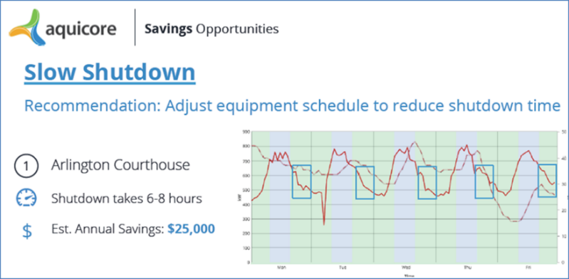
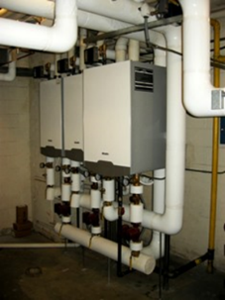
Building Upon Success
Retrofits; retro-commission; schedule smart; new technology.
8

Slide 9
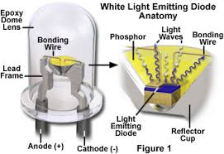
Building Upon Success
The mighty white LED…
… worth a Nobel Prize
9

Slide 10
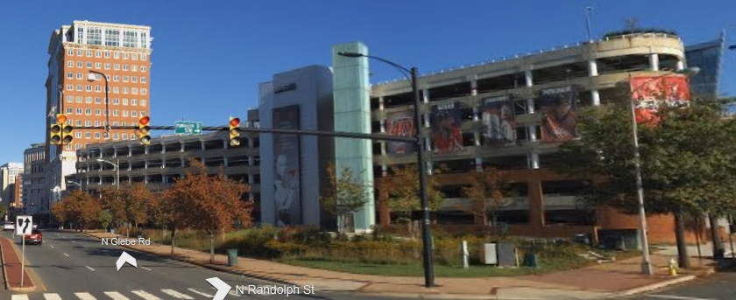
Ballston Garage LED retrofit
2,800 parking space garage, 7 floors, built 1950s
Home to NHL Washington Capitals’ practice facility on top, 2006
10

Slide 11
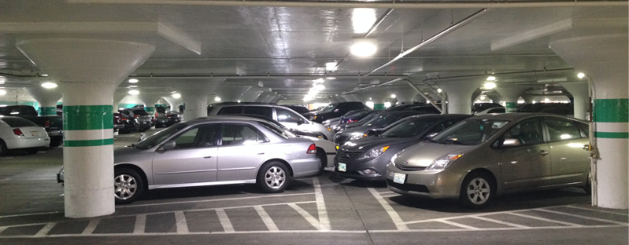
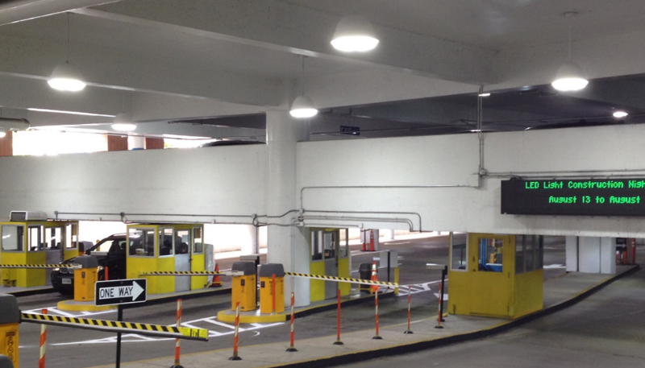
Ballston Garage LED retrofit
11

Slide 12
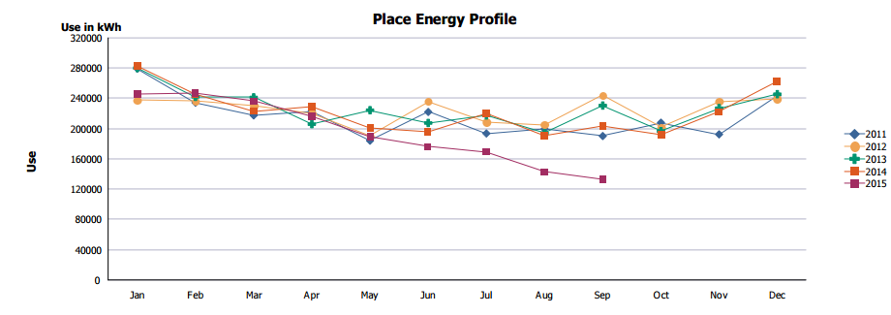
Ballston Garage LED retrofit
~$100,000 annual savings (power + maintenance)
~ 1 million kWh annual savings
12

Slide 13
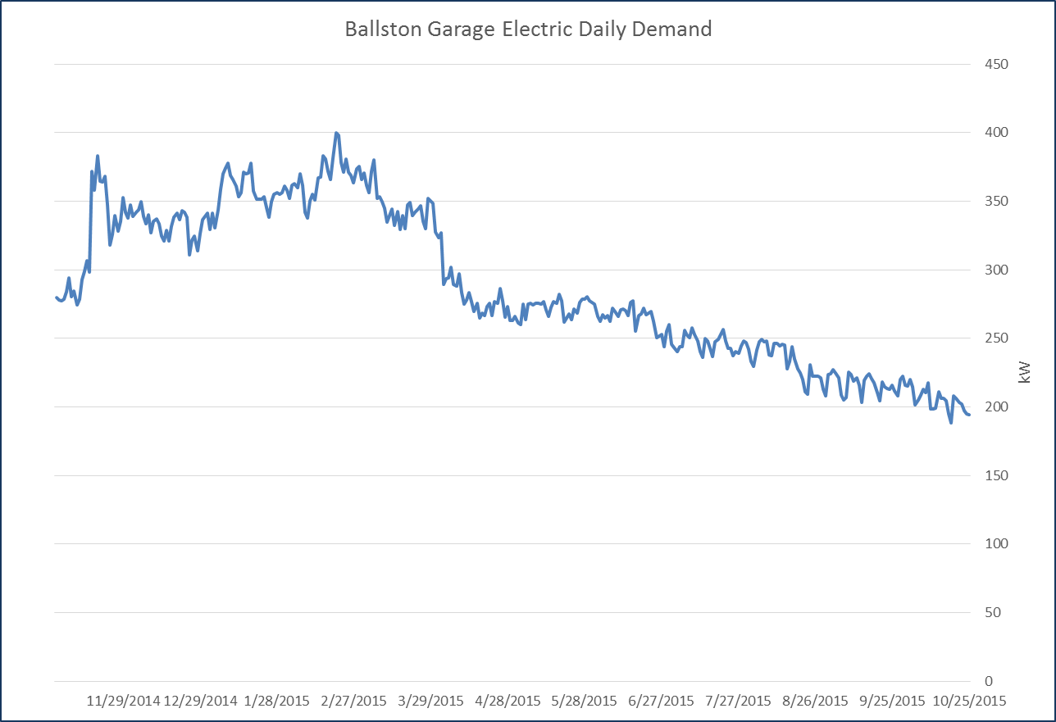
Ballston Garage LED retrofit
13

Slide 14
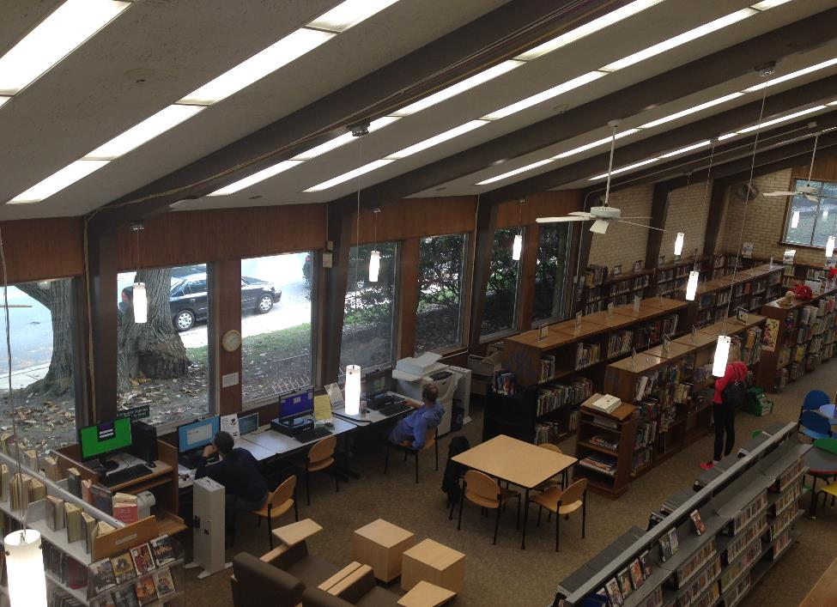
Cherrydale Library LED retrofit
14

Slide 15
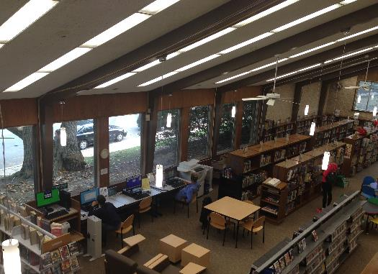
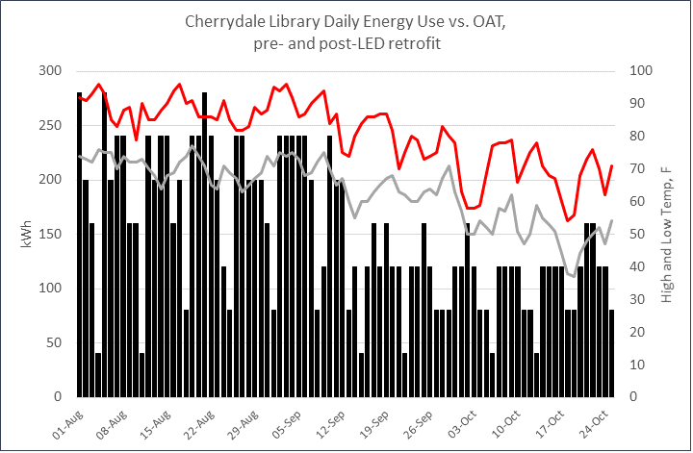
Cherrydale Library LED retrofit
15

Slide 16
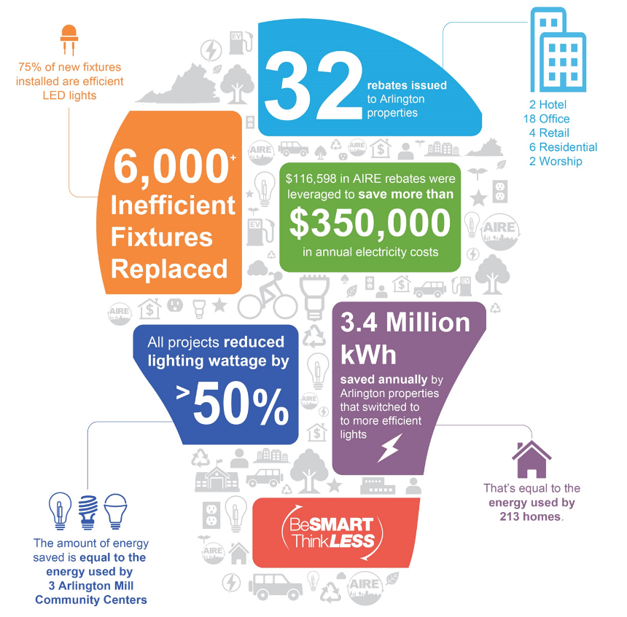
Commercial lighting rebate program 2012-2014
16

Slide 17
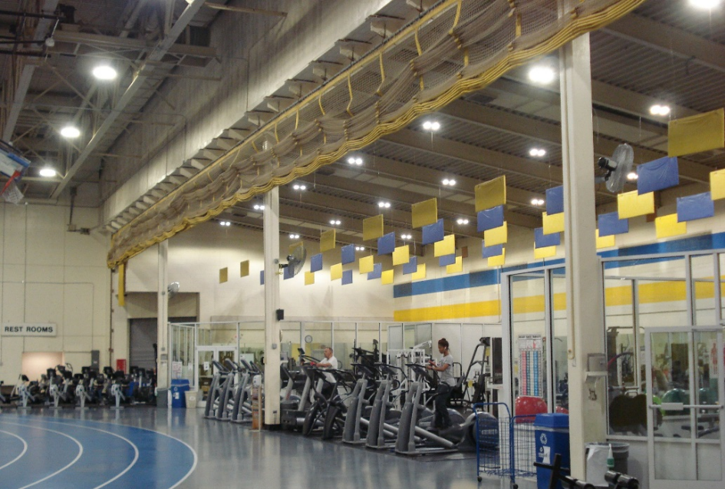
Onward – The future is bright,
we are confident we will achieve goals
Thomas Jefferson Middle School & Community Center – APS gym LED retrofit
17

Slide 18
Thank you
John Morrill – jmorrill@arlingtonva.us
www.arlingtonenergy.us

