Slide 1
Final
CLEAN Power plan
Before the Virginia Energy Efficiency Council
Virginia Department of Environmental Quality
November 12, 2015

Slide 2
FINAL plan BASICS
Final Plan released on August 3, 2015
Employs different method to develop state targets
Uses the proposal’s first three building blocks
  BB1 - Increased power plant efficiency
  BB2 - Shift of generation to NGCC
  BB3 - Increase renewable energy
Fourth proposed building block (energy efficiency) is not included in developing final rule’s state targets

Slide 3
FINAL plan BASICS
Uses regional generation and emission data to develop standard emission rates for coal and natural gas
  1,305 lbs/MWh for coal plants
  771 lbs/MWh for natural gas combined cycle plants (NGCC)
Uses these rates and 2012 generation mix to develop state specific goals
  For Virginia: Coal (1,305 lbs/MWh * 31%) + NGCC (771 lbs/MWh * 69%) = 934 lbs/MWh
VA’s interim goal set at 1,047 lbs/MWh beginning in 2022
Final compliance still required by 2030

Slide 4
HOW DOES THE FINAL PLAN ADDRESS VIRGINIA’S COMMENTS?
Equity – the final rule uses national standards that reduces inequity between state goals
State goals – the final rule reduces differences in state goals and any resulting economic disadvantages between Virginia and its neighbors
Zero emitting sources – the final rule dispenses with the arbitrary crediting of some clean power generation and will allow credit for new nuclear investments in the future
Renewable energy – the final plan is based on an updated national assumption of RE potential and VA’s higher rate goal will lessen the need for major RE ramp-up in the near term
Interim targets – the final rule delays the interim compliance period to 2022 and raises the previously front loaded VA interim goal to avoid the compliance “cliff”
Mass limits – the final rule provides both rate and mass limits for states to use
Reliability – the final rule provides a reliability safety value to address emergency situations and optional set-asides to assist single source assets.

Slide 5
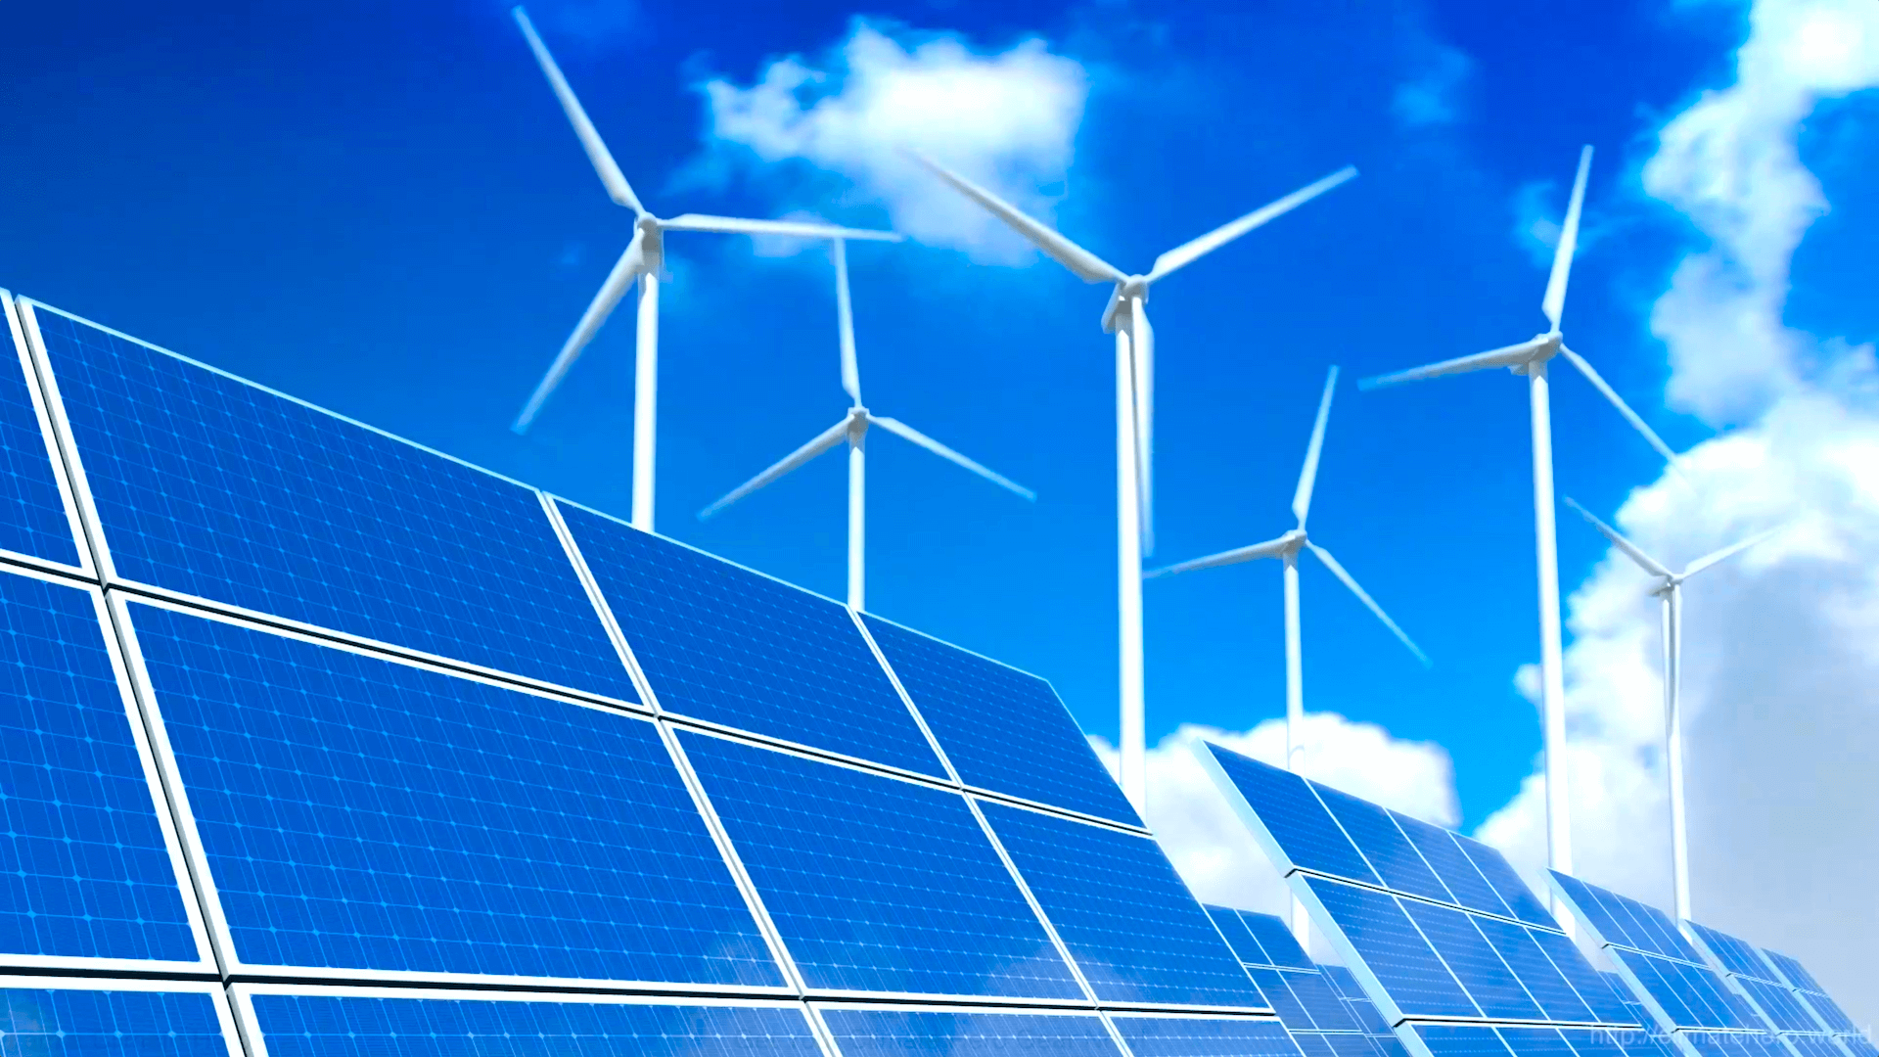
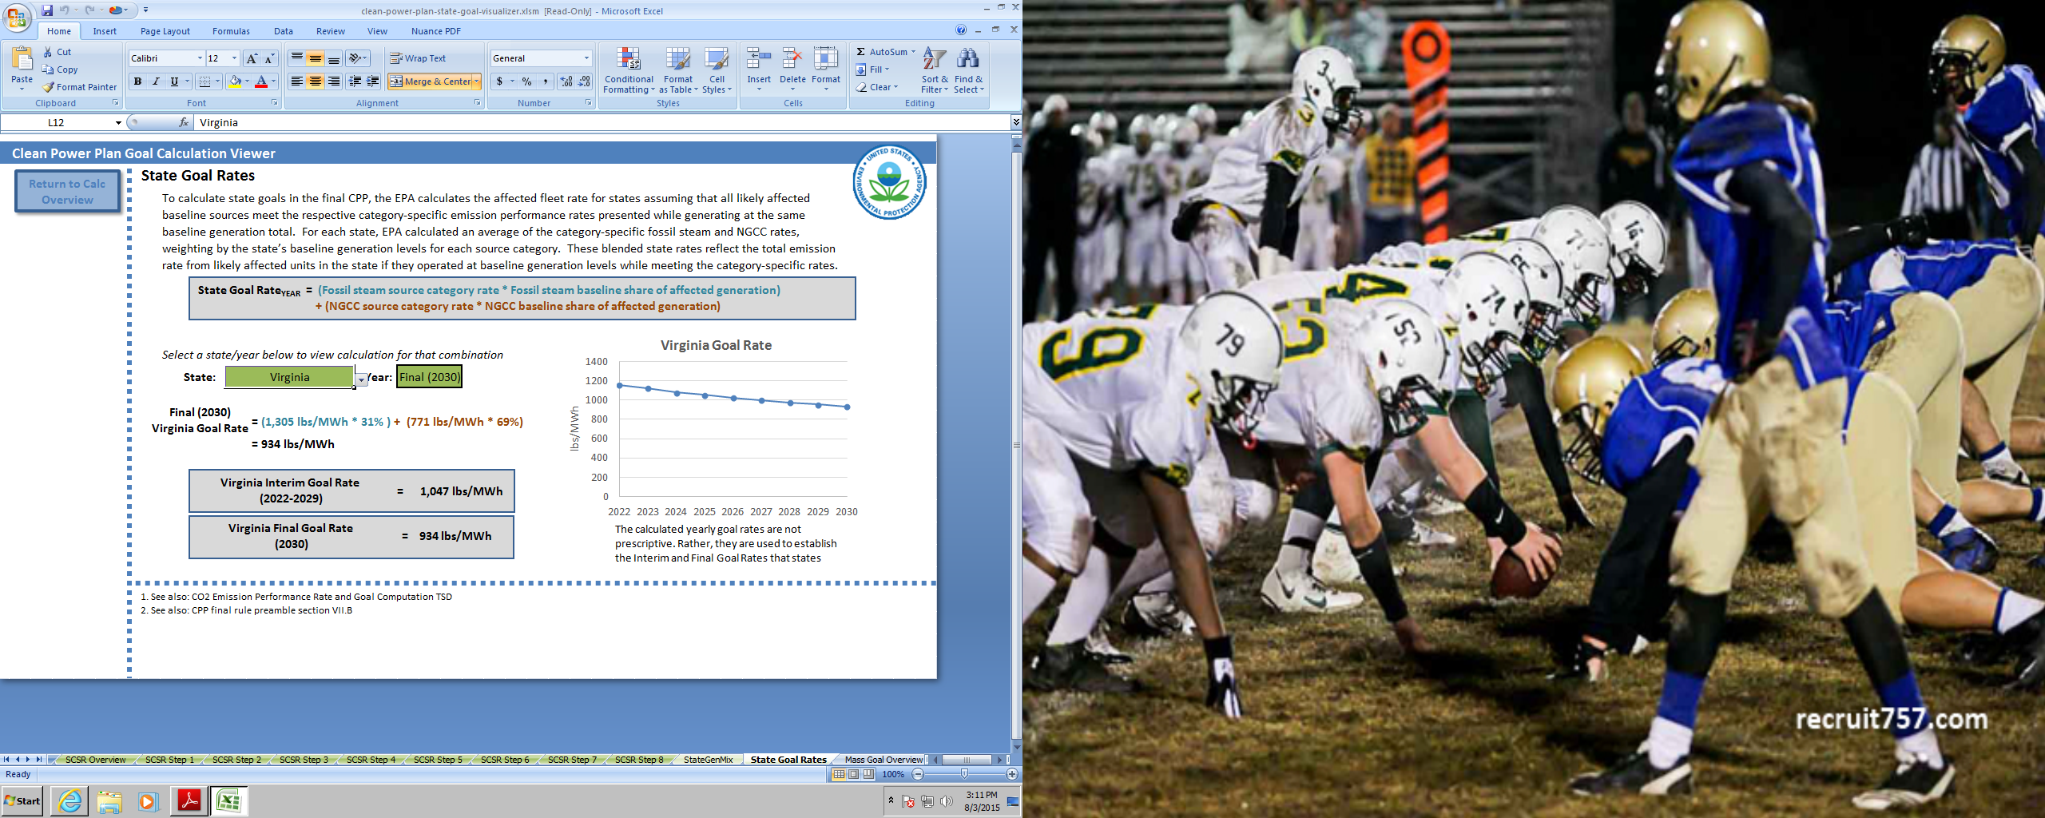
Virginia goals in detail

Slide 6
Virginia emission rate goals

Slide 7
Virginia Mass emissions goals

Slide 8
State compliance PLANS
State can develop a compliance plan subject to EPA timetables and approval
  Flexibility within CPP guidelines
    Myriad issues
    Blessing and curse
  Can adopt EPA model rule
    Presumptively approvable
    Proposed by EPA on October 23rd for rate and mass approaches and open to public comment
    Final sometime next year
States that do not develop and implement an approved EPA compliance plan will have a federal plan imposed on them and implemented by EPA
  No flexibility or state control
  Proposed by EPA on October 23 and open to public comment
  Final sometime next year

Slide 9
State compliance options
The two main compliance plan options are:
  A state emissions standard plan, or
  A state measures plan
Under an emissions standard plan:
  Use established overall rate or mass goals or specific rate/mass goals for specific sources
  Can include only existing (rate) or existing & new sources (mass)
  Can participate in intra or interstate trading facilitated by EPA
  Compliance is determined at the “stack” through monitoring
  Rate based program would require generation and tracking of “emission reduction credits” from RE and EE projects
Under a state measures plan:
  Include a mixture of measures to be implemented by the state including RE and EE standards and other measures
  States choosing this option must also adopt a federally enforceable “backstop”

Slide 10
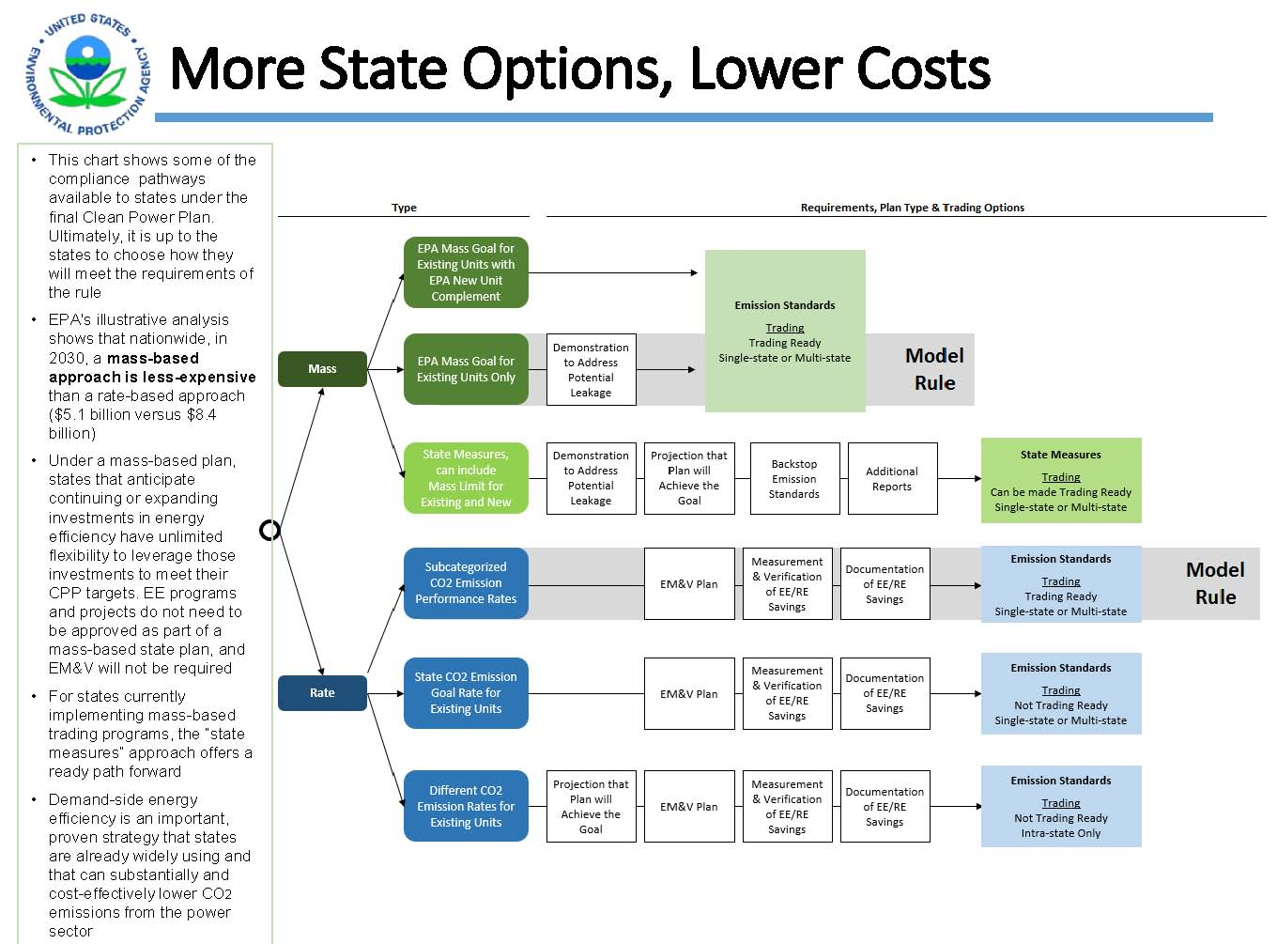

Slide 11
State compliance timeline
September 6 , 2016 – initial submittal with optional extension request
September 6, 2017 – Progress report for states with extensions
September 6, 2018 – Final state plans
July 1, 2021 – Milestone status report
January 1, 2022 to December 31, 2024 – first interim compliance period
January 1, 2025 to December 31, 2027 – second interim compliance period
January 1, 2028 to December 31, 2029 – third interim compliance period
July 1, 2030 – Interim period compliance demonstration
July 1, 2032 and every three years forward – Final compliance demonstration

Slide 12
Virginia’s PUBLIC PARTICIPATION approach
  Informal 60-day public comment period (August 13 – October 13)
  Listening sessions in all 6 Regions (September – October)
  Greenhouse gas web page (ongoing)
  RSS feeds (ongoing)
  Meet with stakeholders (ongoing)
  Facilitated stakeholder process

Slide 13
PLANS AND PLAN COMPONENTS
  Initial Plan or Extension Request due September 2016
    Identify final plan approaches under consideration and describe progress made to date
    Explain why additional time is needed to submit a final plan
    Demonstrate opportunity for public comment, including “meaningful engagement” with “vulnerable communities”
    Include a non-binding statement of intent to participate in the Clean Energy Incentive Program

Slide 14
PLANS AND PLAN COMPONENTS
  Progress report due September 2017
    Summarize status of each component of the final plan
    Commit to a plan approach, including draft or proposed legislation and regulations
    Provide updated roadmap with a schedule and milestones for completing the final plan, including updates to community engagement undertaken and planned

Slide 15
PLANS AND PLAN COMPONENTS
  Final plan due September 2018
    Identification of affected EGUs
    Emission standards
    A federally enforceable backstop that will be put into place if there is a triggering event
    Identification of monitoring, reporting, and recordkeeping requirements for each affected EGU
    Process, contents, and schedule for state reporting
    Subject to formal 30-day public comment period and mandatory hearing

